Slide 1
IAM + GRC CASE STUDY physical access identity sprawl audit and analysis

Slide 2
ENVIRONMENT OVERVIEW & METHODOLOGY
ENVIRONMENT
multi-tenant commercial real estate
physical access control platform: AMAG Symmetry
1,000+ active credentials analyzed
METHODOLOGY
controlled access (active within 60 days)
unused active credentials (issued / never used)
dormant accounts (60+ days without activity)
shared credentials (vendors contractors/visitors)
Evaluation based on badge activity, credential ownership and lifecycle status
This case study demonstrates identity governance analysis techniques. All data and environments have been anonymized and recreated for demonstration purposes only.

Slide 3
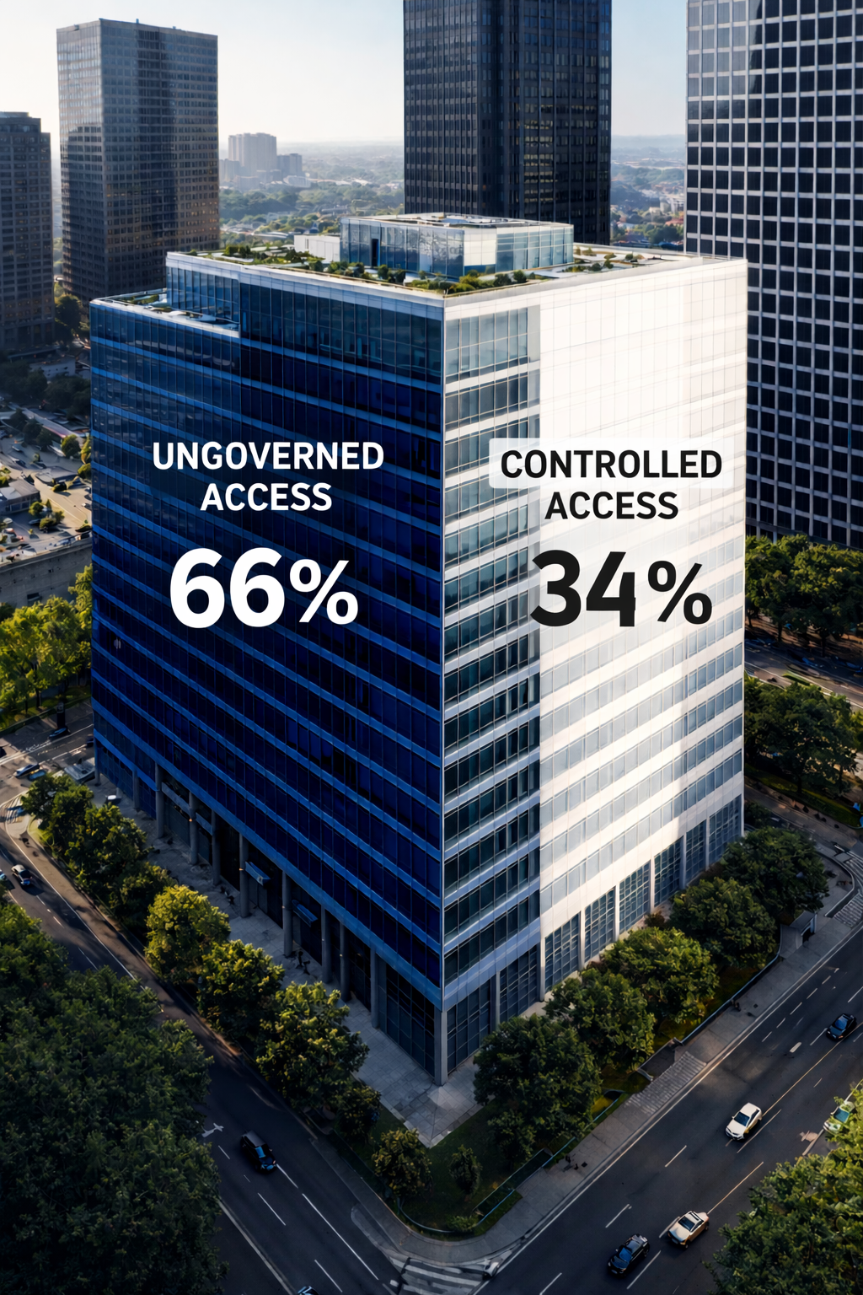

Slide 4

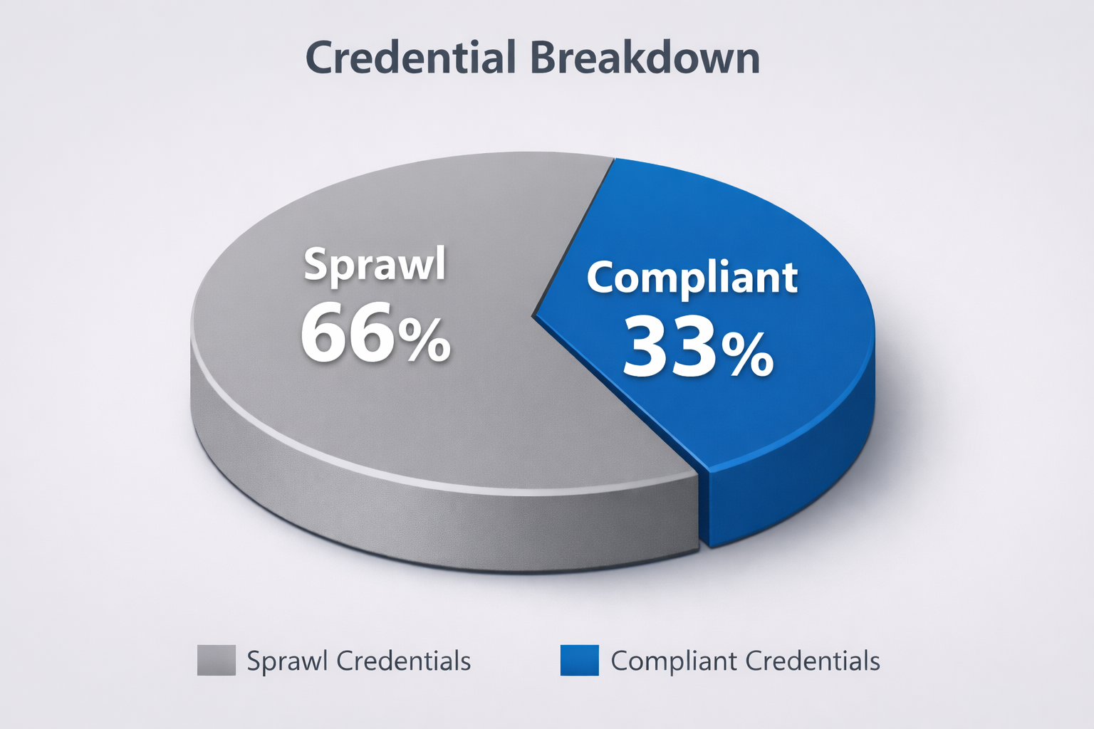
SHARED CREDENTIALS 13%
SPRAWL
RISK LEVEL: HIGH
COMPLIANT CREDENTIALS 33%
RISK LEVEL: LOW
UNUSED ACTIVE REDENTIALS: 43%
SPRAWL
RISK LEVEL: HIGH
DORMANT ACCOUNTS: 10%
SPRAWL
RISK LEVEL: MEDIUM

Slide 5


Slide 6
REMEDIATION STRATEGY:
1 – establish audit & reporting processes
2 – standardize credential lifecycle management based on existing framework
(ISO 27001 & 27002, NIST SP 800-53)
3 – conduct portfolio IAM assessment
PROPERTY 01 serves as a representative example of how identity sprawl develops without centralized identity governance.
This case study demonstrates identity governance analysis techniques. All data and environments have been sanitized and recreated for demonstration purposes only.

